Slide 1


DOCKERS
MACHINE TRAINING
TRENSOR FLOW
CENTAURY APP
REACT NATIVE
ANACONDA

Slide 2

Is the player ready to score a penalti?
The emotions of the player are very important because it, comparing with other penalties, could reveal if the player is like on other occasions in which he has scored a penalty.

Slide 3
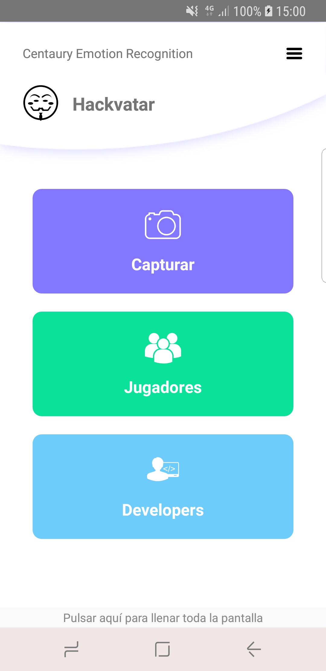
The solution: Centaury
Our solution is based on
Machine training
Analysis of data
Graph of statistic
Statistical analysis not only predictive by statistics, we add the value of the mood of the player to have a higher level of certainty in our analysis.

Slide 4
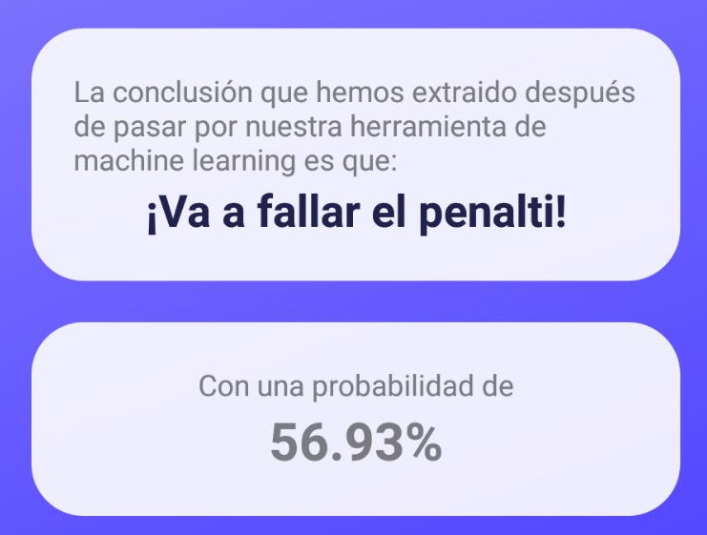





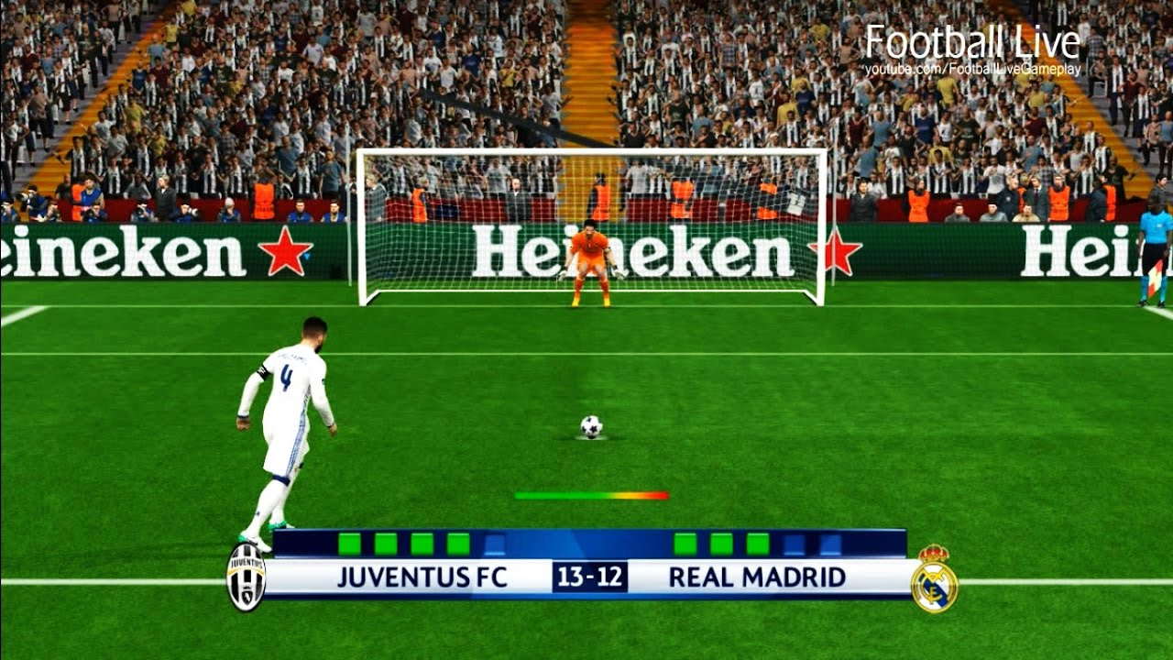


What’s the process?

Slide 5








What’s the intrastructure used in the app?
Machine training
Android
Python
Docker
React Native
Tensor Flow
Machine Learning
Anaconda

Slide 6
Position tomorrow
From this prototype we want to get:
Allow also recognize corporal expressions.
Identification of moods and prediction of performance within the team before each match.
Identifier all players and predict whose have more probability to scored a penalti.
Can used it in streaming.

Slide 7
Repositories
https://github.com/gfelixc/hackatonMAD https://github.com/soyjuanmacias/centaury-app-react-native

